Slide 1
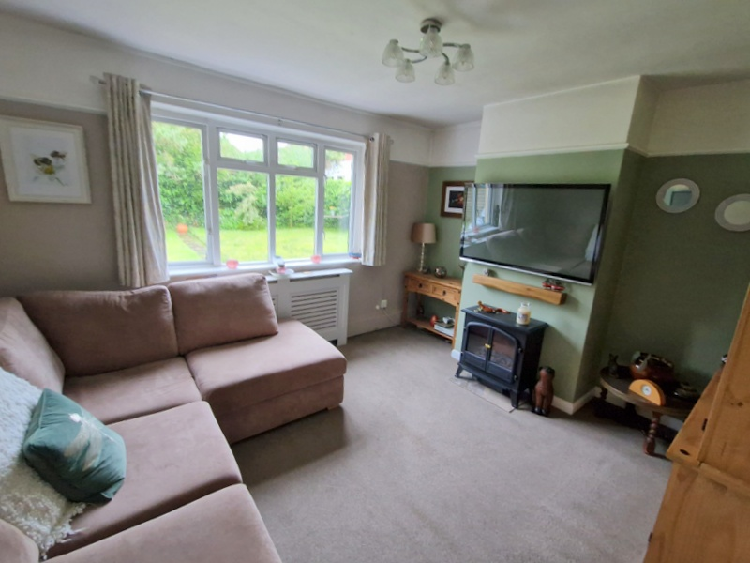
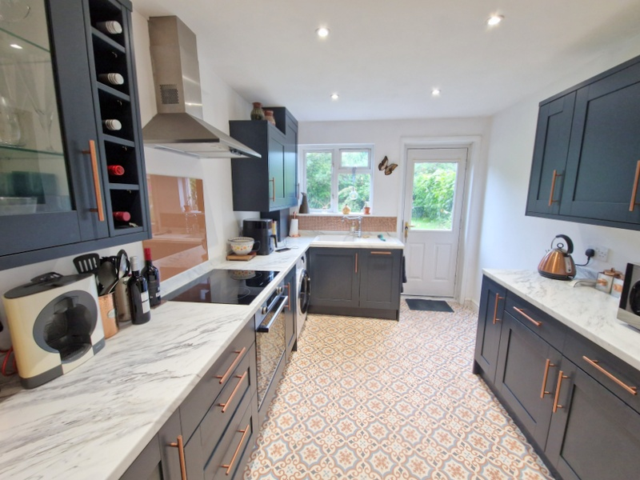
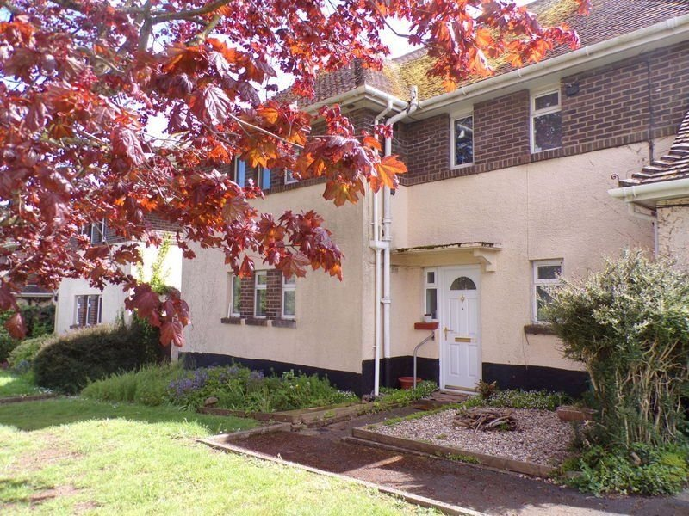
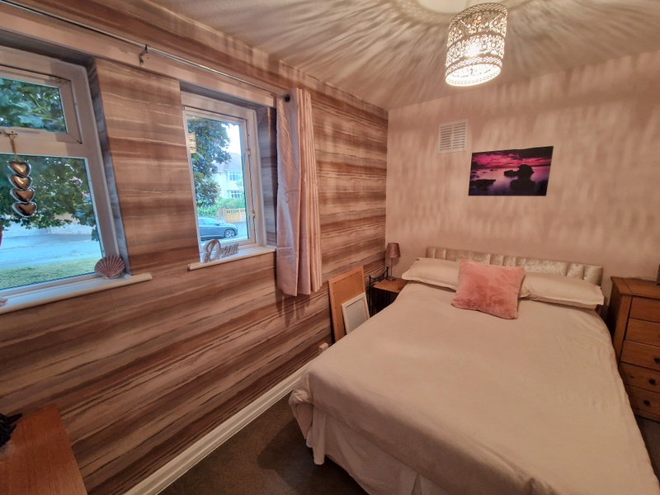
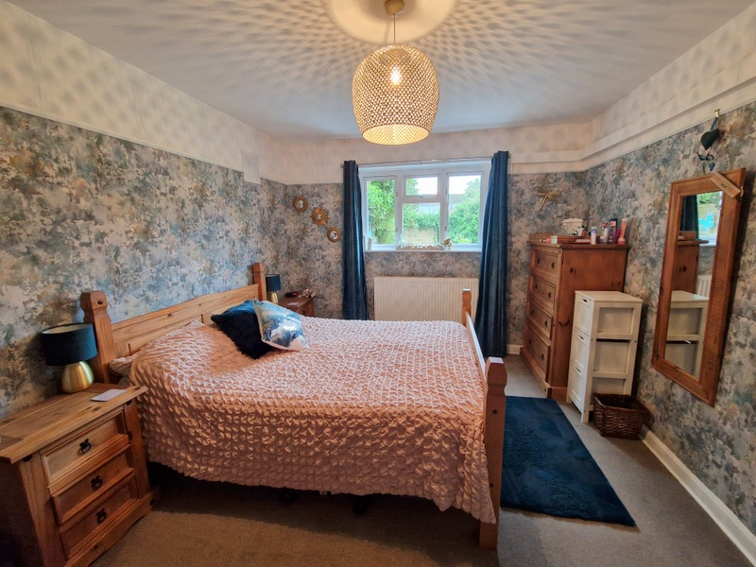
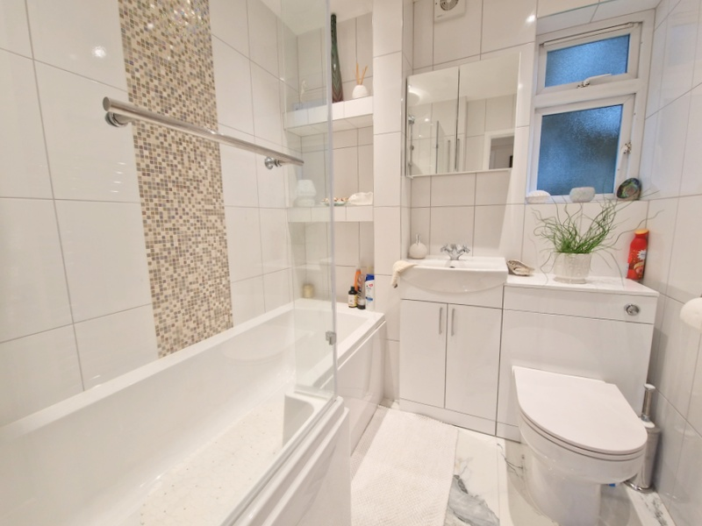
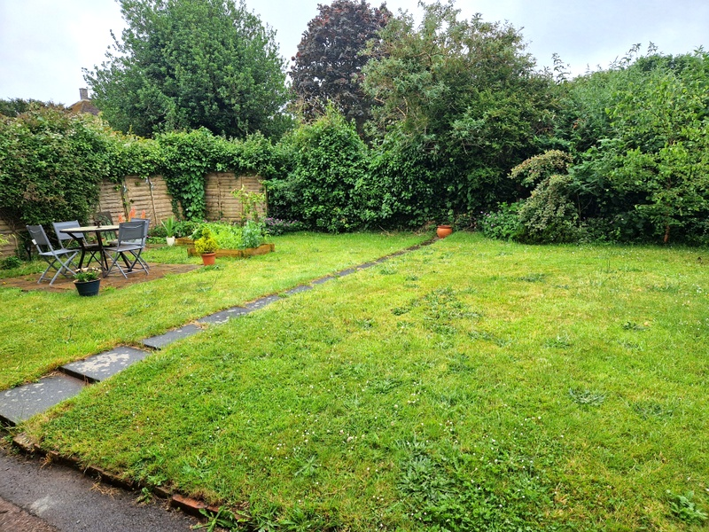
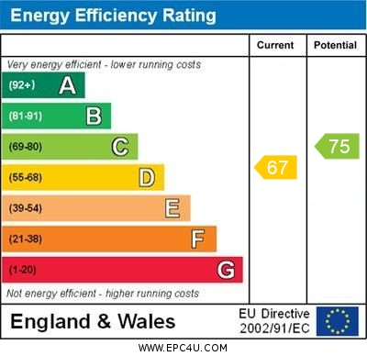
www.pennys.net
72 Moormead, Budleigh Salterotn, EX9 6PY
GUIDE PRICE £249,950
TENURE Leasehold
A Spacious And Refurbished Purpose Built Ground Floor Flat With Its Own Good Size Private And Sunny Rear Garden Situated In A Popular Location Within Easy Access Of Amenities And The Beach
Own Private Front & Rear Doors * Good Size Modern Kitchen/Breakfast Room * Lounge * Two Double Bedrooms * Stylish Modern Bathroom Suite * Gas Central Heating & Double Glazed Windows * Large Private Garden * Outside Store/Potential Office
Pennys Estate Agents Limited for themselves and for the vendor of this property whose agents they are give notice that:- (1) These particulars do not constitute any part of an offer or a contract. (2) All statements contained in these particulars are made without responsibility on the part of Pennys Estate Agents Limited. (3) None of the statements contained in these particulars are to be relied upon as a statement or representation of fact. (4) Any intending purchaser must satisfy himself/herself by inspection or otherwise as to the correctness of each of the statements contained in these particulars. (5) The vendor does not make or give and neither do Pennys Estate Agents Limited nor any person in their employment has any authority to make or give any representation or warranty whatever in relation to this property.
PENNYS ESTATE AGENTS
2 Rolle House, Rolle Street, Exmouth, Devon, EX8 2SN
Tel: 01395 264111 EMail: help@pennys.net

Slide 2
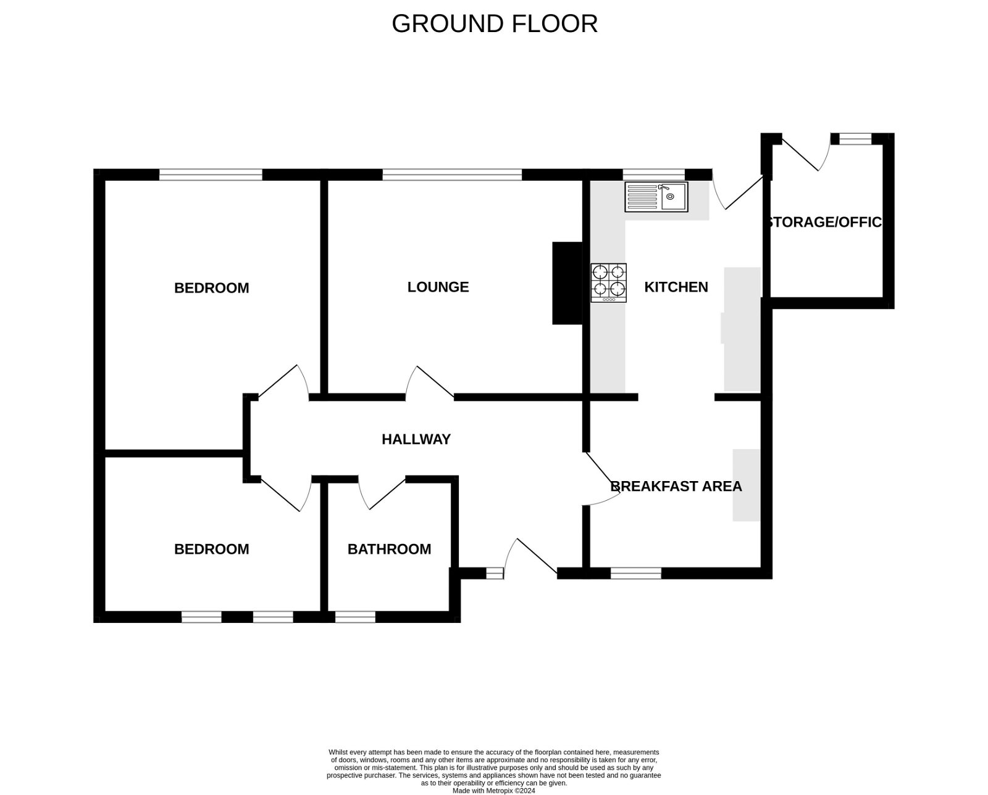
72 Moormead, Budleigh Salterton, EX9 6PY
THE ACCOMMODATION COMPRISES:
ENTRANCE CANOPY: Composite front door with patterned arched glazed window inset giving access to the:
RECEPTION HALL: Radiator with shelf over, doors giving access to all rooms, coat rack, cupboard housing the electric consumer unit and meter, central heating thermostat control, smoke detector.
LOUNGE: 12' 11" (3.94m) into wall recess x 11' 0" (3.35m) A south facing, light and airy room with double glazed window overlooking the rear garden, radiator housed in radiator cover, television point, picture rail.
KITCHEN/BREAKFAST ROOM: 5.49m x 2.69m (18'0" x 8'10") A modern stylish refitted kitchen with range of patterned worktops with ceramic single drainer sink unit with cupboards and drawer units, plumbing for automatic washing machine and integrated dishwasher beneath worktops with matching splashbacks. Inset induction hob with glass splashback and chimney style extractor hood over, built-in oven, wall mounted cupboards, incorporating one glass fronted display unit and wine rack, wall mounted gas boiler supplying hot water and central heating housed in matching kitchen unit. Space for upright fridge/freezer, upright radiator, double glazed window and door giving access to the rear garden with further double glazed window to front aspect. Recessed ceiling LED spotlighting in kitchen area.
BEDROOM ONE: 13' 6" (4.11m) x 10' 10" (3.3m) maximum overall measurement. Double glazed window overlooking the rear garden, radiator; picture rail.
BEDROOM TWO: 3.3m x 2.34m (10'10" x 7'8") Two double glazed windows to front aspect; radiator.
BATHROOM/WC: 2.13m x 1.91m (7'0" x 6'3") Superb modern suite with bath with shower unit over with fixed rainfall shower head hose and detachable shower head hose, wash hand basin with cabinet beneath, WC with concealed cistern with push button flush, mirror fronted medicine cabinet, extractor fan, chrome heated towel rail, double glazed window, tiled floor and attractively tiled walls.
OUTSIDE: To the rear of the flat and accessed via a side pathway with gate is the property's own private good sized and sunny rear garden which is fully enclosed and comprises of patio sun terrace areas; lawned garden areas. Also from the side pathway access is gained to a large private orchard for use of the residents of Moormead only. From the private garden access to:
ATTACHED BRICK BUILDING/POTENTIAL OFFICE: 8' 0" x 6' 0" (2.44m x 1.83m) With double glazed patterned window.
AGENTS NOTE: Prospective purchasers of this property must comply with Section 157 of the Housing Act 1985.
TENURE & OUTGOINGS: The property is held on 125 year lease commencing on 2nd June 2003 until 1st June 2128. Ground rent is £10 per annum. Service and maintenance charges are annual and variable.
FLOOR PLAN:

